Slide 1
Linear Regression

Slide 2
Agenda
1
Simple Linear Regression
2
Multiple Linear Regression

Slide 3
Simple Linear Regression
Target
Suggest a market plan for next year that will result in high product sales?
What information would be useful in order to provide such a recommendation?

Slide 4
Market Plan: Questions
Some of the questions we might seek to answer:
Is there a relationship between advertising budget and sales?
Our goal should be to determine whether the data provide evidence of an association between advertising expenditure and sales.
If the evidence is weak, then one might argue that no money should be spent on advertising!
How strong is the relationship between advertising budget and sales?
Assuming that there is a relationship between advertising and sales, we would like to know the strength of this relationship.
In other words, given a certain advertising budget, can we predict sales with a high level of accuracy? This would be a strong relationship.
Or is a prediction of sales based on advertising expenditure only slightly better than a random guess? This would be a weak relationship?

Slide 5
Market Plan: Questions
Which media contribute to sales?
Do all three media TV, radio and newspaper contribute to sales or do just one or two of the media contribute?
How accurately can we estimate the effect of each medium on sales?
For every dollar spent on advertising in a particular medium, by what amount will sales increase?
How accurately can we predict this amount of increase?
How accurately can we predict future sales?
For any given level of television, radio or newspaper advertising, what is our prediction for sales and what is the accuracy of this prediction?

Slide 6
Market Plan
Linear regression can be used to answer each of these questions

Slide 7
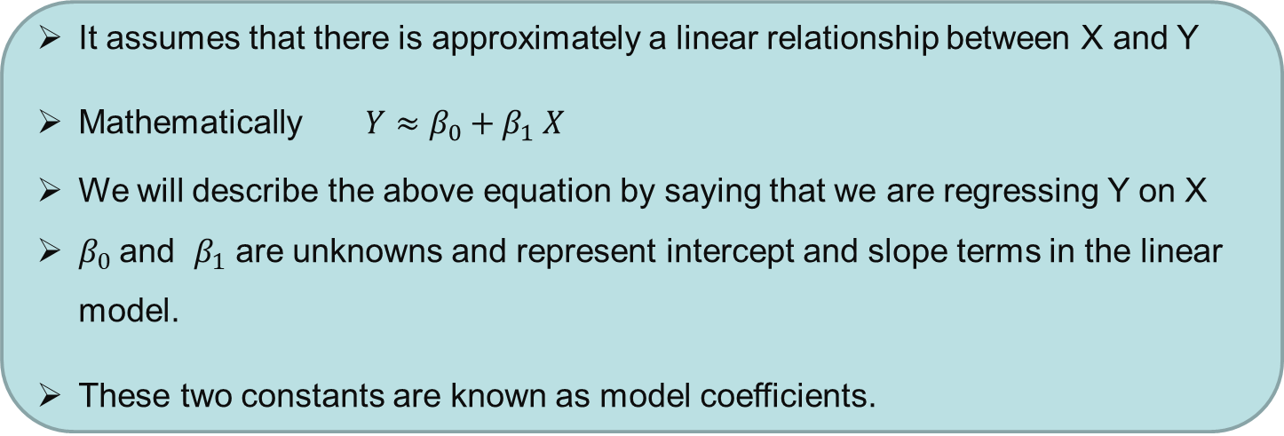
Simple Linear Regression
Linear regression is a useful tool for predicting a quantitative response
Simple linear regression is a straightforward approach for predicting quantitative response Y on the basis of a single predictor variable X.
It assumes that there is approximately a linear relationship between X and Y
Mathematically $Y≈β_{0}+β_{1} X$
We will describe the above equation by saying that we are regressing Y on X
$β_{0}$and $β_{1}$ are unknowns and represent intercept and slope terms in the linear model.
These two constants are known as model coefficients.

Slide 8
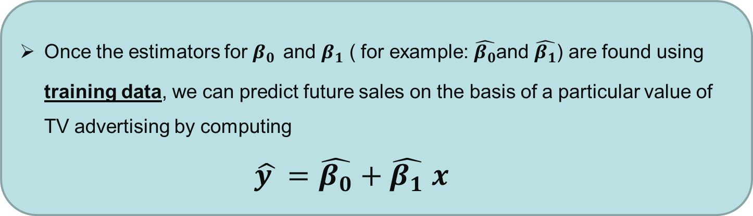
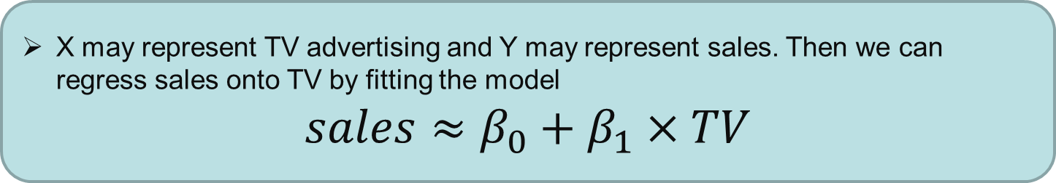
Simple Linear Regression: Example
X may represent TV advertising and Y may represent sales. Then we can regress sales onto TV by fitting the model
$$sales≈β_{0}+β_{1}×TV$$
Once the estimators for $β_{0}$ and $β_{1}$ ( for example: $\hat{β_{0}}$and $\hat{β_{1}}$) are found using training data, we can predict future sales on the basis of a particular value of TV advertising by computing
$\hat{y }=\hat{β_{0}}+\hat{β_{1}} x$

Slide 9
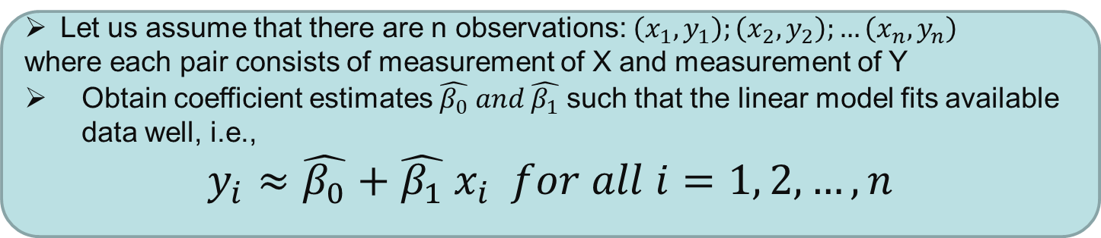

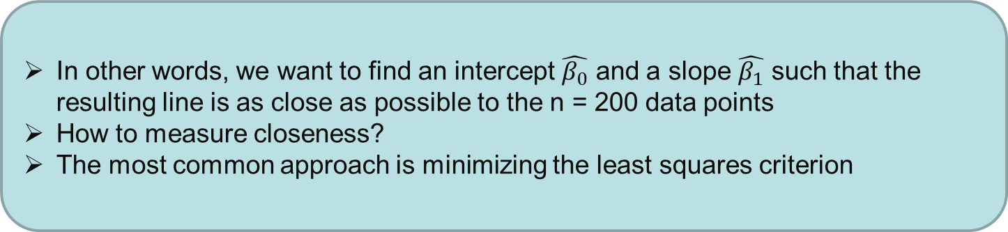
Estimating Coefficients: $β_{0} and β_{1}$
Let us assume that there are n observations: $\left(x_{1}, y_{1}\right);\left(x_{2}, y_{2}\right);…\left(x_{n}, y_{n}\right)$
where each pair consists of measurement of X and measurement of Y
Obtain coefficient estimates $\hat{β_{0}} and \hat{β_{1}}$ such that the linear model fits available data well, i.e.,
$$y_{i}≈\hat{β_{0}}+\hat{β_{1}} x_{i} for all i=1, 2, …,n$$
In other words, we want to find an intercept $\hat{β_{0}}$ and a slope $\hat{β_{1}}$ such that the resulting line is as close as possible to the n = 200 data points
How to measure closeness?
The most common approach is minimizing the least squares criterion

Slide 10

Estimating Coefficients: $β_{0} and β_{1}$
Find model coefficients for S$ales≈β_{0}+β_{1}×TV$
$$\hat{β_{0}}=7.03 and \hat{β_{1}}=0.0475$$

Slide 11

Interpreting Coefficients: $β_{0} and β_{1}$
Every $1000 spent on TV advertising is associated with selling 47.5 units of the product

Slide 12

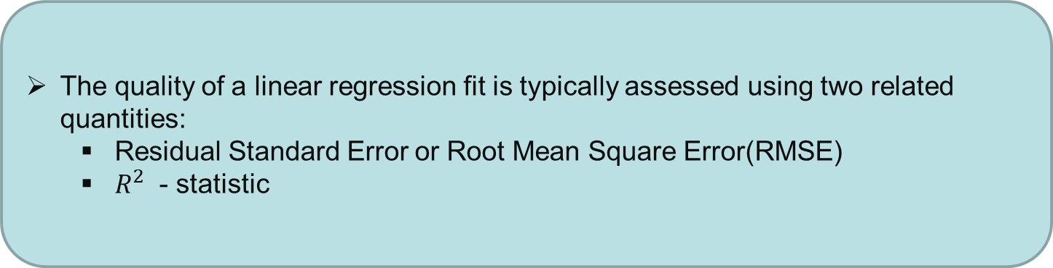
Assessing the accuracy of the model
The quality of a linear regression fit is typically assessed using two related quantities:
Residual Standard Error or Root Mean Square Error(RMSE)
$R^{2}$ - statistic
Question: Analyse RMSE for
$$sales≈β_{0}+β_{1}×TV$$

Slide 13
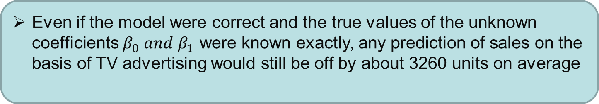
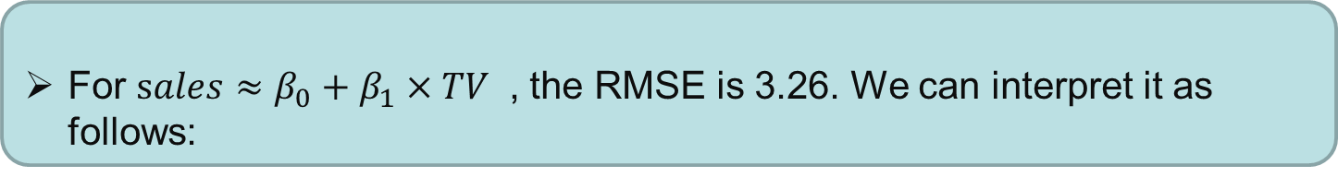
Interpreting the model
For $sales≈β_{0}+β_{1}×TV$ , the RMSE is 3.26. We can interpret it as follows:
Actual sales in each market deviate from the true regression line by approximately 3,260 units on average
Even if the model were correct and the true values of the unknown coefficients $β_{0} and β_{1}$ were known exactly, any prediction of sales on the basis of TV advertising would still be off by about 3260 units on average

Slide 14
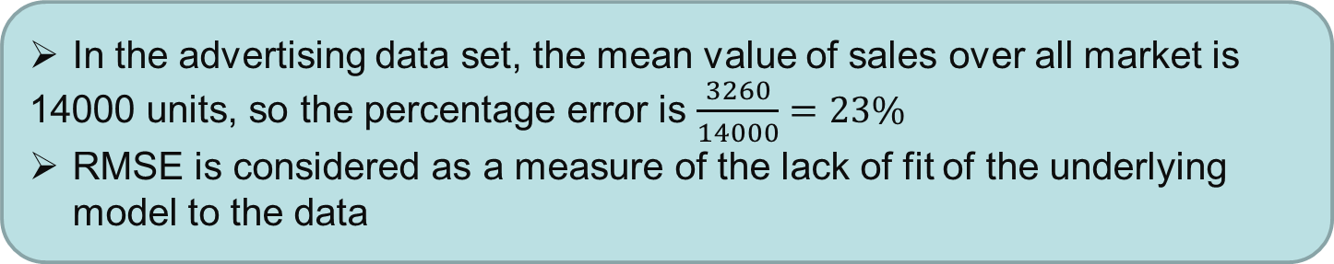
Interpreting the model
Question: Find the mean value of sales over all markets in advertising data?
In the advertising data set, the mean value of sales over all market is
14000 units, so the percentage error is $\frac{3260}{14000}=23\%$
RMSE is considered as a measure of the lack of fit of the underlying model to the data

Slide 15
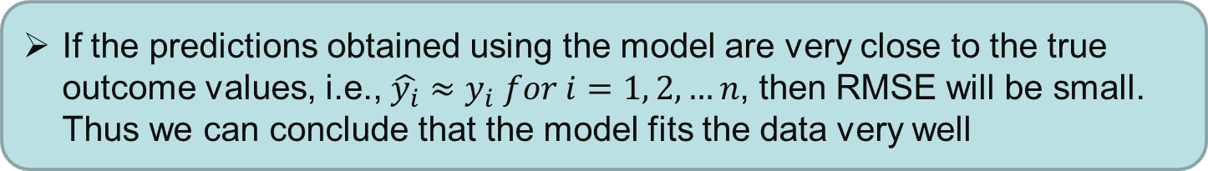
Assessing the accuracy of the model
If the predictions obtained using the model are very close to the true outcome values, i.e., $\hat{y_{i}}≈y_{i} for i=1, 2, …n$, then RMSE will be small. Thus we can conclude that the model fits the data very well
If $\hat{y_{i} }$ is far from $y_{i}$ for one or more observations, then the RMSE may be quite large, indicating that the model does not fit the data well
Since RMSE is measured in the units of Y, it is not clear what constitutes a good RMSE
$R^{2}$ statistic provides an alternative measure of fit

Slide 16
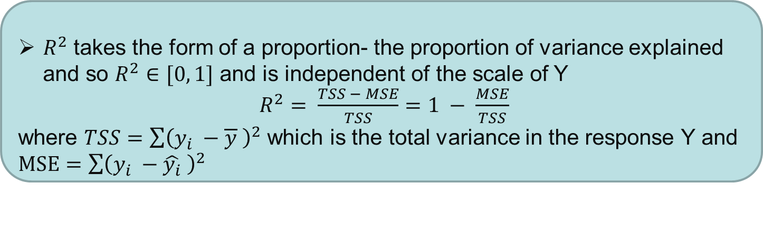
Assessing the accuracy of the model
$R^{2}$ takes the form of a proportion- the proportion of variance explained and so $R^{2}∈[0, 1]$ and is independent of the scale of Y
$R^{2}= \frac{TSS − MSE}{TSS}=1 − \frac{MSE}{TSS}$
where $TSS=\sum{{\left(y_{i} −\overline{y} \right)}^{2}}$ which is the total variance in the response Y and $MSE=\sum{{\left(y_{i} −\hat{y_{i}} \right)}^{2}}$
TSS can be thought of as the amount of variability inherent in the response before the regression is performed
In contrast, MSE measures the amount of variability that is left unexplained after performing the regression.
Thus, TSS-MSE measures the amount of variability in the response that is explained by performing the regression
$R^{2}$ measures the proportion of variability in Y that can be explained using X

Slide 17
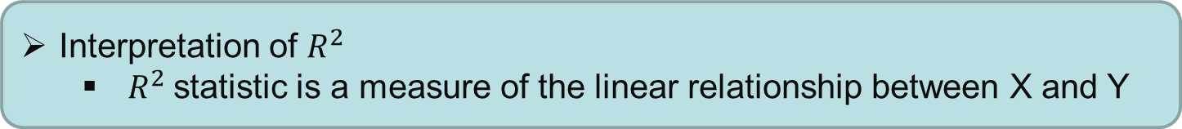
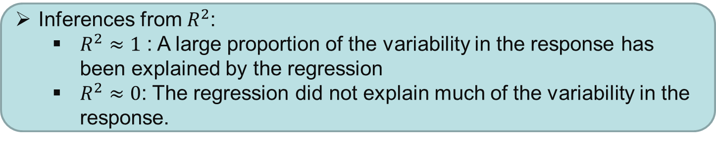
Assessing the accuracy of the model
Inferences from $R^{2}$:
$R^{2}≈1$ : A large proportion of the variability in the response has been explained by the regression
$R^{2}≈0$: The regression did not explain much of the variability in the response.
Interpretation of $R^{2}$
$R^{2}$statistic is a measure of the linear relationship between X and Y
Recall that correlation is also a measure of the linear relationship between X and Y

Slide 18

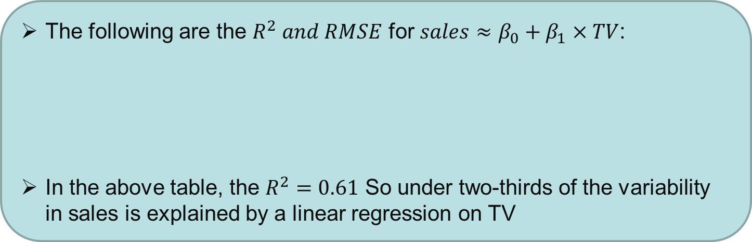
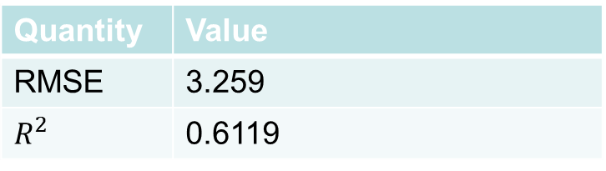
Assessing the accuracy of the model
Find $R^{2}$ for $sales≈β_{0}+β_{1}×TV$ model and analyze the result?
The following are the $R^{2} and RMSE$ for $sales≈β_{0}+β_{1}×TV$:
In the above table, the $R^{2}=0.61$ So under two-thirds of the variability in sales is explained by a linear regression on TV
Quantity | Value
RMSE | 3.259
$$R^{2}$$ | 0.6119

Slide 19
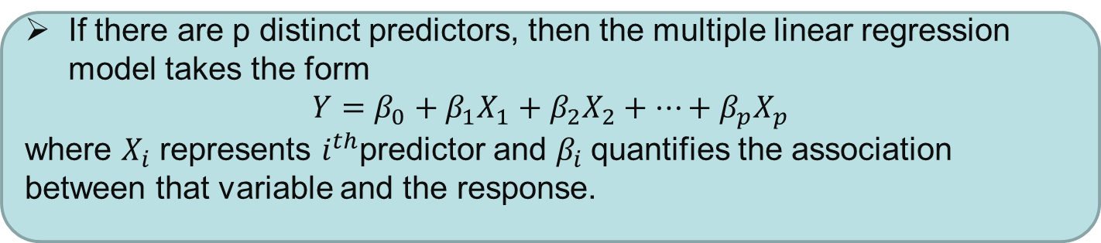
Multiple Linear Regression
How to extend SLR in order to use other available information in the data set?
If there are p distinct predictors, then the multiple linear regression model takes the form
$Y=β_{0}+β_{1}X_{1}+β_{2}X_{2}+⋯+β_{p}X_{p}$
where $X_{i}$ represents $i^{th}$predictor and $β_{i}$quantifies the association between that variable and the response.

Slide 20

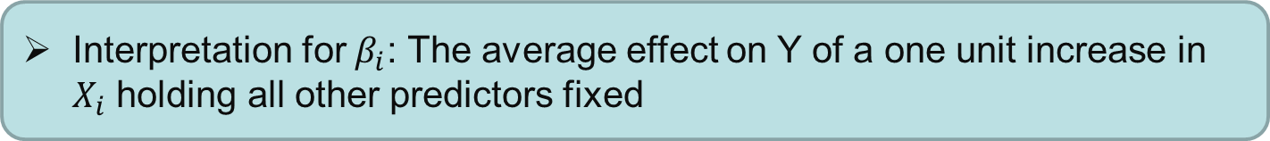

Multiple Linear Regression
Interpretation for $β_{i}$: The average effect on Y of a one unit increase in $X_{i}$ holding all other predictors fixed
For advertising example, multiple linear regression equation becomes
$$sales=β_{0}+β_{1}×TV+β_{2}×Radio+β_{3}×Newspaper$$
Given $\hat{β_{i}}$ which is estimate of $β_{i}$, we can make predictions using the following formula:
$$\hat{y}=\hat{β_{0}}+\hat{β_{1}} x_{1}+\hat{β_{2}} x_{2}+⋯+\hat{β_{p}} x_{p}$$

Slide 21
Multiple Linear Regression
Consider advertising data and fit multiple linear regression
Analyze model coefficient estimates?

Slide 22
Multiple Linear Regression
For a given amount of TV and newspaper advertising, spending an additional $1000 on radio advertising leads to an increase in sales by approximately 189 units
Compare multiple linear regression coefficients with simple linear regression coefficients:
TV and Radio coefficients estimates are similar
Newspaper simple linear regression coefficients is significantly non-zero, whereas in multiple linear regression model, this coefficient is close to 0
Observe that SLR and MLR coefficients can be very different
What are the differences of SLR and MLR? What does slope of newspaper advertising in SLR and in MLR represent?

Slide 23
Multiple Linear Regression
Does it make sense for the MLR to suggest no relationship between sales and newspaper while the SLR implies the opposite?
Calculate the correlation matrix of predictors
Observe the correlation between radio and newspaper and it is 0.35. This reveals a tendency to spend more on newspaper advertising in markets where more is spent on radio advertising.

Slide 24
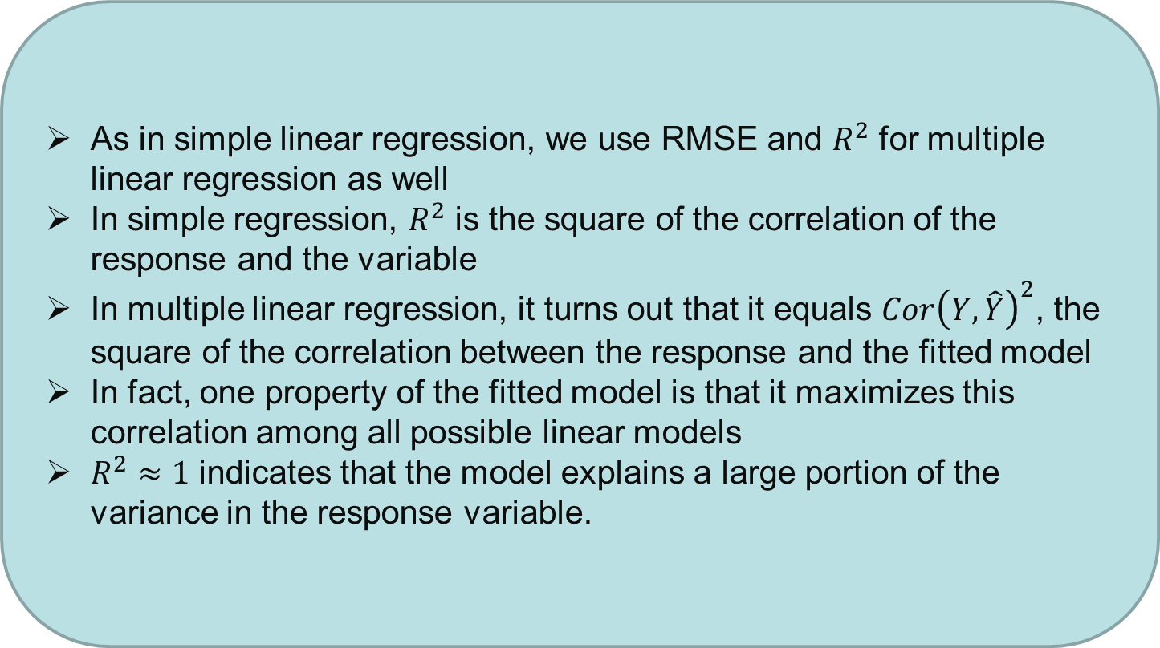
MLR: Model Fit
As in simple linear regression, we use RMSE and $R^{2}$ for multiple linear regression as well
In simple regression, $R^{2}$ is the square of the correlation of the response and the variable
In multiple linear regression, it turns out that it equals $Cor{\left(Y, \hat{Y}\right)}^{2}$, the square of the correlation between the response and the fitted model
In fact, one property of the fitted model is that it maximizes this correlation among all possible linear models
$R^{2}≈1$ indicates that the model explains a large portion of the variance in the response variable.

Slide 25
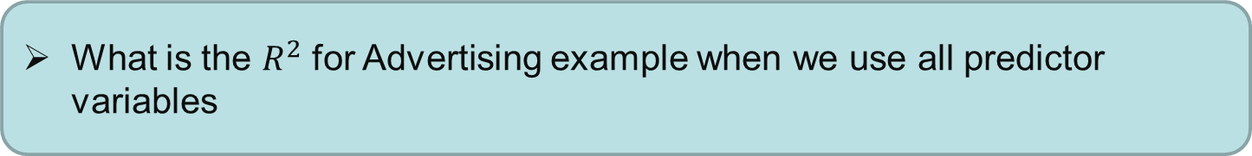
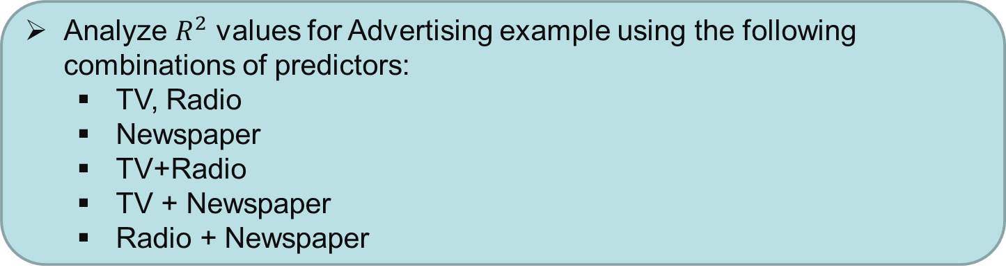
MLR: Model Fit
What is the $R^{2}$ for Advertising example when we use all predictor variables
$R^{2}$ in this case is 0.8972
Analyze $R^{2}$ values for Advertising example using the following combinations of predictors:
TV, Radio
Newspaper
TV+Radio
TV + Newspaper
Radio + Newspaper

Slide 26
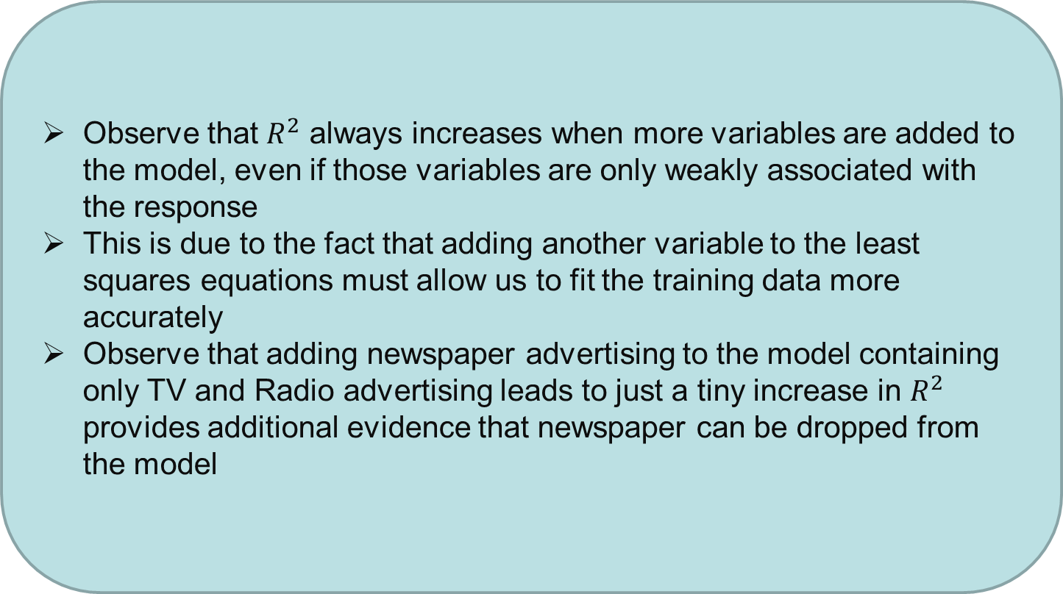
MLR: Model Fit
Observe that $R^{2}$ always increases when more variables are added to the model, even if those variables are only weakly associated with the response
This is due to the fact that adding another variable to the least squares equations must allow us to fit the training data more accurately
Observe that adding newspaper advertising to the model containing only TV and Radio advertising leads to just a tiny increase in $R^{2}$ provides additional evidence that newspaper can be dropped from the model

Slide 27
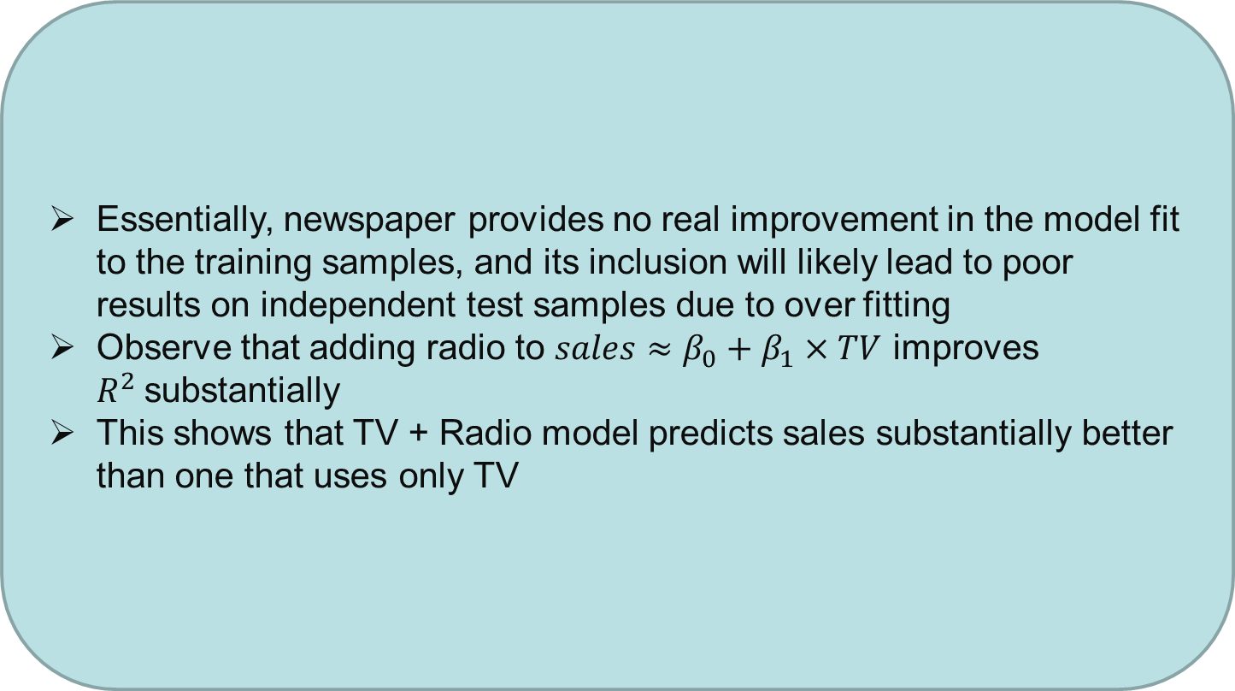
MLR: Model Fit
Essentially, newspaper provides no real improvement in the model fit to the training samples, and its inclusion will likely lead to poor results on independent test samples due to over fitting
Observe that adding radio to $sales≈β_{0}+β_{1}×TV$ improves $R^{2}$substantially
This shows that TV + Radio model predicts sales substantially better than one that uses only TV

Slide 28
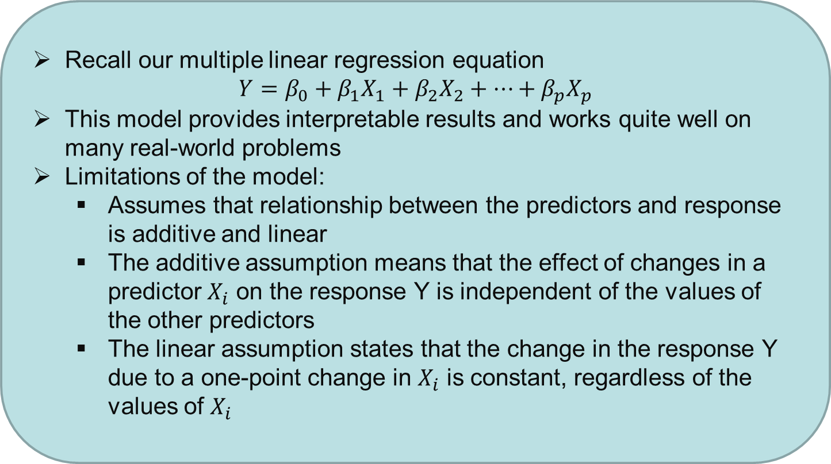
Extension of the linear model
Recall our multiple linear regression equation
$$Y=β_{0}+β_{1}X_{1}+β_{2}X_{2}+⋯+β_{p}X_{p}$$
This model provides interpretable results and works quite well on many real-world problems
Limitations of the model:
Assumes that relationship between the predictors and response is additive and linear
The additive assumption means that the effect of changes in a predictor $X_{i}$ on the response Y is independent of the values of the other predictors
The linear assumption states that the change in the response Y due to a one-point change in $X_{i}$ is constant, regardless of the values of $X_{i}$

Slide 29
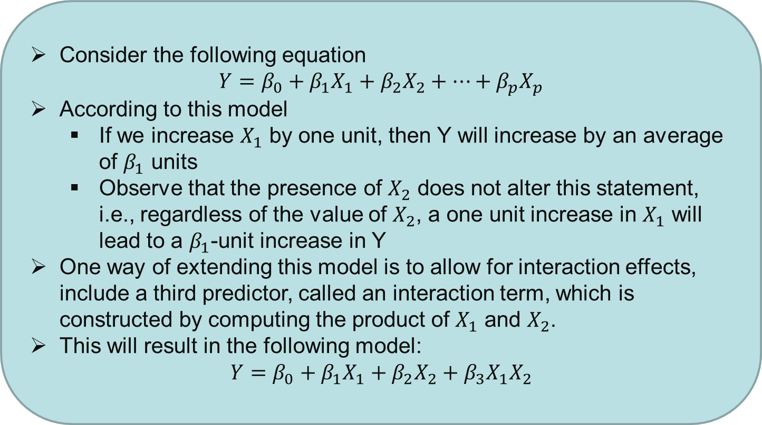
MLR: Removing the additive assumption
Consider the following equation
$$Y=β_{0}+β_{1}X_{1}+β_{2}X_{2}+⋯+β_{p}X_{p}$$
According to this model
If we increase $X_{1}$ by one unit, then Y will increase by an average of $β_{1}$ units
Observe that the presence of $X_{2}$ does not alter this statement, i.e., regardless of the value of $X_{2}$, a one unit increase in $X_{1}$ will lead to a $β_{1}$-unit increase in Y
One way of extending this model is to allow for interaction effects, include a third predictor, called an interaction term, which is constructed by computing the product of $X_{1}$ and $X_{2}$.
This will result in the following model:
$$Y=β_{0}+β_{1}X_{1}+β_{2}X_{2}+β_{3}X_{1}X_{2}$$

Slide 30
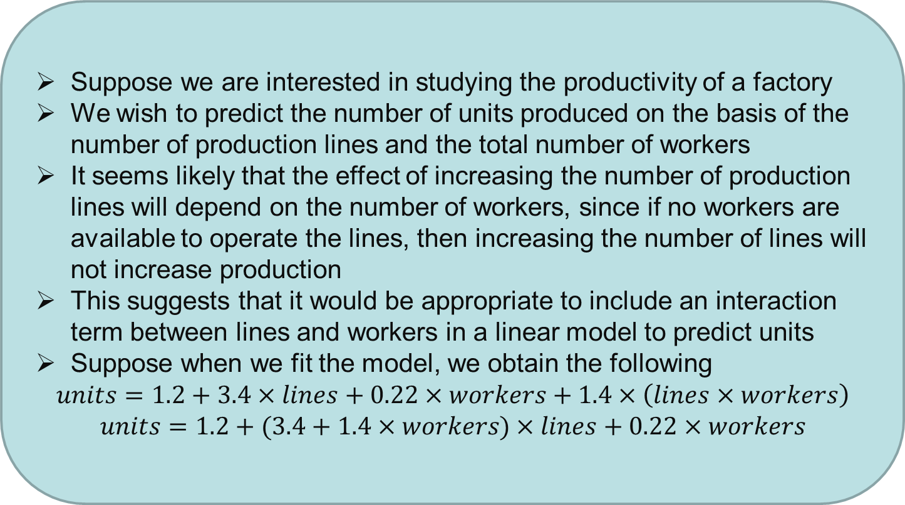
Extension of MLR: Example
Suppose we are interested in studying the productivity of a factory
We wish to predict the number of units produced on the basis of the number of production lines and the total number of workers
It seems likely that the effect of increasing the number of production lines will depend on the number of workers, since if no workers are available to operate the lines, then increasing the number of lines will not increase production
This suggests that it would be appropriate to include an interaction term between lines and workers in a linear model to predict units
Suppose when we fit the model, we obtain the following
$$units=1.2+3.4×lines+0.22×workers+1.4×\left(lines×workers\right)$$
$$units=1.2+(3.4+1.4×workers)×lines+0.22×workers$$

Slide 31
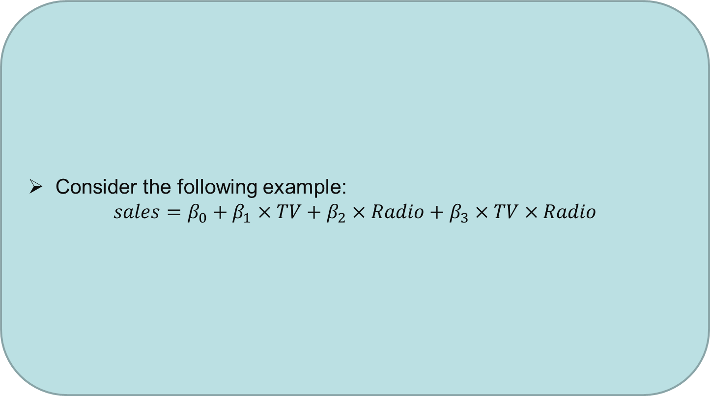
Extension of MLR: Example
Consider the following example:
$$sales=β_{0}+β_{1}×TV+β_{2}×Radio+β_{3}×TV×Radio$$

Slide 32
Comparison of Multiple Regression Models
Model | Predictors | Beta_0 | Beta_1 | Beta_2 | Beta_3 | RMSE | RMSE % | R^2
M1 | TV | 7.03 | 0.0475 |  |  | 3.259 | 23 | 0.61
M2 | Radio | 9.31 | 0.2025 |  |  | 4.275 | 30.5 | 0.33
M3 | NewsPaper | 12.35 | 0.055 |  |  | 5.092 | 36 | 0.05
M4 | TV, Radio | 2.92 | 0.045 | 0.188 |  | 1.681 | 12 | 0.8972
M5 | TV, NewsPaper | 5.77 | 0.047 | 0.044 |  | 3.12 | 22 | 0.64
M6 | Radio, NewsPaper | 9.188 | 0.199 | 0.006 |  | 4.28 | 30.5 | 0.33
M7 | TV, Radio, NewsPaper | 2.939 | 0.045 | 0.188 | -0.001 | 1.686 | 12 | 0.8972
M8 | TV, Radio, TV*Radio | 6.75 | 0.019 | 0.029 | 0.001 | 0.943 | 6.7 | 0.968

Slide 33
Potential Problems in Linear Regression
When we fit a linear regression model to a particular data set, many problems may occur. Most common among these are the following:
Non-linearity of the response-predictor relationships
Non-constant variance of error terms
Outliers
High-leverage points
Collinearity

Slide 34
Lab
Consider Advertising Data Set
Build the best model to predict Sales
Interpret Intercept and Slope for each of the above combinations

Slide 35
Lab
Consider Credit Data Set
Build the best model to predict Credit Balance
Interpret Intercept and Slope for each of the above combinations

Slide 36
Lab
Consider car-mpg Data Set
Build the best model to predict mpg
Interpret Intercept and Slope for each of the above combinations

Slide 37
Questions?
?

Slide 38
Thanks!

